Slide 1


Thesis Advisory Committee Meeting -1
Pravein Govindan Kannan
Advisor : Prof. Chan Mun Choon
Notes:
Hello Everyone.
Thanks for attending the thesis advisory committee.
So, let me introduce myself formally, I am Pravein, I am entering the 4th year of my PhD

Slide 2
Agenda
Raptor: Rule Placement in SDN (~10 min)
BNV: Bare metal network virtualization (~30 min)
Ongoing/Future Work (~10 min)
Notes:
Let me lay out the agenda for this presentation :
Initially, I will be giving a 10-min quick run through of my first work, Raptor which is a scalable rule placement scheme in Software defined networks.
Next, I will be talking about the work I was doing last year, which is BNV, a bare-metal network virtualization technique
Finally, I will conclude with the work

Slide 3

Raptor: Scalable Rule Placement over Multiple Path in Software Defined Networks
IFIP Networking 2017
Notes:
Let me go into Raptor, a scalable rule placement scheme for multi-path/dynamic traffic in software defined networks.

Slide 4

Software Defined Networking
Network Policies
Access Control (ACL)
Traffic Measurement
Rate Limiting
Traffic Engineering
App1
App2
App n
SDN Controller
OpenFlow
Forwarding
Forwarding
Forwarding
Forwarding
Raptor
Notes:
In Software Defined Networking, Switches implement forwarding, and controller configures the entire network by implementing Network policies.
Benefit of this being, the controller gets a complete view of the network, and can operate network policies considering the entire network as a single switch.
Network policies could typically be :
Access control, which limits the communication for certain traffic.
Traffic measurements.
Rate limiting on the traffic throughput
And certain types of traffic engineering.

Slide 5
Network Policies translation to Switches
PRIORITY
MAC SRC
MAC DST
IP SRC
IP DST
TCP Dport
TCP SPort
VLAN ID
...
ACTION
Rule Matching
Action
Raptor
Notes:
The network policies are implemented by rules in the switches, which match on the headers and take the corresponding actions.
For any incoming packet to a switch, it has to be matched with all the rules, and takes the action of it’s corresponding matched rule.

Slide 6
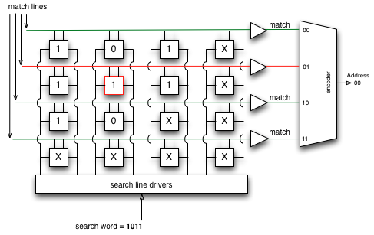
Network Policies to Switches
Where is the Flow tables (rules) Stored?
TCAM
Expensive
Power-Hungry (~60%)
Few thousand Entries (1K-10K)
Increasing demands for individual policies(per-flow)
Rule placement is crucial to scale!!
Raptor
Notes:
These rules are stored in a high speed look-up memory knows as TCAM(Ternany content addressable memory)
which does the entire search operation in a single lookup,
However, it is very expensive, power hungry, and limited to few thousand entries in the switches.
And, with increasing demands for per-flow policies in virtualized data-centers,
rule placement is very crucial in-order to support the increasing demands.

Slide 7
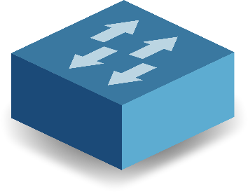
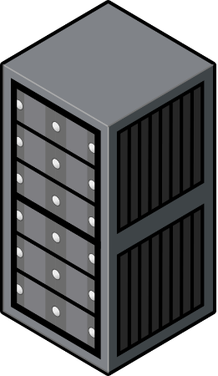
Rule Placement Scenarios
Match
S3
S6
ID | Source | Destination | Action
1 | H1(00) and tcp-port:80 | H3(10) and tcp-port:80 | Drop
2 | H2(01) | H3,H4(1*) and tcp-port:443 | Drop
3 | All(*) | H4(11) | Counter
4 | All(*) | All(*) and tcp-port :22 | Drop
H1 (00)
H3 (10)
S1
S5
S4
S7
H2 (01)
H4 (11)
S2
Raptor
Notes:
Let me illustrate rule placement by example.
Let’s consider the following 4 rules to be placed on the network with 4 hosts H1,H2, H3 and H4, connected by the underlying network.
Basically, the rules have the match criterion as the source and destination IP, and the port number optionally and finally the action to be taken for that match.

Slide 8
Placement of Rules at Ingress
S3
S6
ID | Source | Destination | Action
1 | H1(00) and tcp-port:80 | H3(10) and tcp-port:80 | Drop
2 | H2(01) | H3,H4(1*) and tcp-port:443 | Drop
3 | All(*) | H4(11) | Counter
4 | All(*) | All(*) and tcp-port :22 | Drop
H1 (00)
H3 (10)
S1
S5
S4
S7
H2 (01)
H4 (11)
S2
Raptor
Notes:
Lets, consider the default placement implemented by SDN Controllers, where rules are placed on the ingress of the network, where it applies to.

Slide 9
Placement of Rules at Ingress
S3
S6
ID | Source | Destination | Action
1 | H1(00) and tcp-port:80 | H3(10) and tcp-port:80 | Drop
2 | H2(01) | H3,H4(1*) and tcp-port:443 | Drop
3 | All(*) | H4(11) | Counter
4 | All(*) | All(*) and tcp-port :22 | Drop
H1 (00)
H3 (10)
1
S1
S5
S4
S7
H2 (01)
H4 (11)
S2
Raptor
Notes:
Looking at Rule 1: since it applies to traffic between H1 and H3, It is placed in Switch S1, which is the ingress switch for this particular traffic.

Slide 10
Placement of Rules at Ingress
S3
S6
ID | Source | Destination | Action
1 | H1(00) and tcp-port:80 | H3(10) and tcp-port:80 | Drop
2 | H2(01) | H3,H4(1*) and tcp-port:443 | Drop
3 | All(*) | H4(11) | Counter
4 | All(*) | All(*) and tcp-port :22 | Drop
H1 (00)
H3 (10)
1
S1
S5
S4
S7
H2 (01)
2
H4 (11)
S2
Raptor
Notes:
Consider Rule 2, which applied between H2, and H3/H4. Hence, this rule will be placed in Switch S2, which is ingress switch of this packet path.

Slide 11
Placement of Rules at Ingress
3
S3
S6
ID | Source | Destination | Action
1 | H1(00) and tcp-port:80 | H3(10) and tcp-port:80 | Drop
2 | H2(01) | H3,H4(1*) and tcp-port:443 | Drop
3 | All(*) | H4(11) | Counter
4 | All(*) | All(*) and tcp-port :22 | Drop
H1 (00)
H3 (10)
1
3
S1
S5
3
S4
S7
H2 (01)
2
3
H4 (11)
S2
Raptor
Notes:
Consider Rule 3, which applies to traffic originating from all hosts towards H4. Hence, this rule is applied to all the ingress switches S1, S2, S6 and S7

Slide 12
Placement of Rules at Ingress
3
4
S3
S6
ID | Source | Destination | Action
1 | H1(00) and tcp-port:80 | H3(10) and tcp-port:80 | Drop
2 | H2(01) | H3,H4(1*) and tcp-port:443 | Drop
3 | All(*) | H4(11) | Counter
4 | All(*) | All(*) and tcp-port :22 | Drop
H1 (00)
H3 (10)
1
3
4
S1
S5
3
4
S4
S7
H2 (01)
2
3
4
H4 (11)
S2
Problem :
No. of Rules limited to Capacity of Ingress switches.
Total Rules Needed = 10
Raptor
Notes:
And Rule 4 similarly, applies to traffic between all pairs of hosts. Hence., needs to be placed in all ingress switches.
Hence, after placing all the rules/policies. Overall number of rules needed to implement the policies is 10.
This is the most simple rule-placement scheme, however
The Problem is that number of rules is limited to capacity of ingress switches, which could be limited and in the order of few thousands.

Slide 13
Existing works on Rule Placement
VCRIB [NSDI 13], PALETTE [INFOCOM 13], OBS [CoNext 13]
S3
S6
ID | Source | Destination | Action
1 | H1(00) and tcp-port:80 | H3(10) and tcp-port:80 | Drop
2 | H2(01) | H3,H4(1*) and tcp-port:443 | Drop
3 | All(*) | H4(11) | Counter
4 | All(*) | All(*) and tcp-port :22 | Drop
H1 (00)
H3 (10)
S1
S5
S4
S7
H2 (01)
H4 (11)
S2
Raptor
Notes:
To solve this scalability problem, there are a range of works which perform placement of rules by splitting and offloading the rules along the path of traffic.

Slide 14
Existing works on Rule Placement
VCRIB [NSDI 13], PALETTE [INFOCOM 13], OBS [CoNext 13]
Address Scalability problem → Offload Rules along the path
3
4
S3
S6
ID | Source | Destination | Action
1 | H1(00) and tcp-port:80 | H3(10) and tcp-port:80 | Drop
2 | H2(01) | H3,H4(1*) and tcp-port:443 | Drop
3 | All(*) | H4(11) | Counter
4 | All(*) | All(*) and tcp-port :22 | Drop
H1 (00)
H3 (10)
1
3
4
S1
S5
4
S4
S7
H2 (01)
2
3
4
H4 (11)
S2
Raptor

Slide 15
Existing works on Rule Placement
VCRIB [NSDI 13], PALETTE [INFOCOM 13], OBS [CoNext 13]
Address Scalability problem → Offload Rules along the path
3
4
S3
S6
ID | Source | Destination | Action
1 | H1(00) and tcp-port:80 | H3(10) and tcp-port:80 | Drop
2 | H2(01) | H3,H4(1*) and tcp-port:443 | Drop
3 | All(*) | H4(11) | Counter
4 | All(*) | All(*) and tcp-port :22 | Drop
H1 (00)
H3 (10)
1
3
4
S1
S5
4
S4
S7
H2 (01)
2
3
4
H4 (11)
S2
Raptor

Slide 16
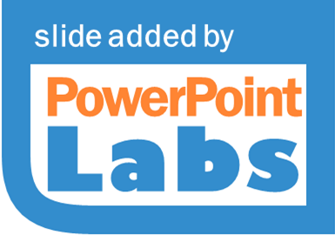
Existing works on Rule Placement
VCRIB [NSDI 13], PALETTE [INFOCOM 13], OBS [CoNext 13]
Address Scalability problem → Offload Rules along the path
3
4
S3
S6
ID | Source | Destination | Action
1 | H1(00) and tcp-port:80 | H3(10) and tcp-port:80 | Drop
2 | H2(01) | H3,H4(1*) and tcp-port:443 | Drop
3 | All(*) | H4(11) | Counter
4 | All(*) | All(*) and tcp-port :22 | Drop
H1 (00)
H3 (10)
1
3
4
S1
S5
4
S4
S7
H2 (01)
2
3
4
H4 (11)
S2
Raptor

Slide 17
Existing works on Rule Placement
VCRIB [NSDI 13], PALETTE [INFOCOM 13], OBS [CoNext 13]
Address Scalability problem → Offload Rules along the path
4
3
S3
S6
ID | Source | Destination | Action
1 | H1(00) and tcp-port:80 | H3(10) and tcp-port:80 | Drop
2 | H2(01) | H3,H4(1*) and tcp-port:443 | Drop
3 | All(*) | H4(11) | Counter
4 | All(*) | All(*) and tcp-port :22 | Drop
H1 (00)
H3 (10)
1
3
4
S1
S5
3
4
4
S4
S7
H2 (01)
2
H4 (11)
S2
Problem :
Flows restricted to Single Path :
Dynamic Load Balancing
Path Failures.
Total Rules Needed >= 10
Raptor
Notes:
Hence, now the rules are split to avoid any conflicts, and offloaded onto the path of the applicable traffic.
The total number of rules in the network will be greater than 10, due to conflict resolution, which causes rules to be splitted and hence increases the number of rules needed.
The problems of these schemes are that,
The rules are placed considering the single path for a flow; Hence, upon path failures, it needs to re-calculate and place the rules in the alternative path. Same goes for load-balancing dynamically.
Hence, its not very practical for networks with dynamic flows and traffic engineering.

Slide 18
Existing works on Rule Placement
PALETTE [INFOCOM 13], OBS [CoNext 13] , VCRIB[NSDI 13]
Address Scalability problem → Offload Rules along the path
4
3
S3
S6
ID | Source | Destination | Action
1 | H1(00) and tcp-port:80 | H3(10) and tcp-port:80 | Drop
2 | H2(01) | H3,H4(1*) and tcp-port:443 | Drop
3 | All(*) | H4(11) | Counter
4 | All(*) | All(*) and tcp-port :22 | Drop
H1 (00)
H3 (10)
1
3
4
S1
S5
3
4
4
S4
S7
H2 (01)
2
H4 (11)
S2
Problem :
Flows restricted to Single Path :
Dynamic Load Balancing
Path Failures.
Total Rules Needed >= 10
Naïve Duplication of rules in multi-path is not scalable!! Can we do Better?
Raptor
Notes:
We can consider naïve duplication of rules to support multipath, however again, its not very scalable. Can we do better?

Slide 19
Raptor
Key Idea : Rule Sharing !!
3
4
S3
S6
ID | Source | Destination | Action
1 | H1(00) and tcp-port:80 | H3(10) and tcp-port:80 | Drop
2 | H2(01) | H3,H4(1*) and tcp-port:443 | Drop
3 | All(*) | H4(11) | Counter
4 | All(*) | All(*) and tcp-port :22 | Drop
H1 (00)
H3 (10)
1
3
4
S1
S5
3
4
S4
S7
H2 (01)
2
3
4
H4 (11)
S2
Shareable Rules
Raptor
Notes:
In Raptor, the key idea is to identify rules that are applicable to various flows, and placing them at certain points in network, where it can be shared.
For example, rule 3 and 4 are applicable to more than 1 host pair, hence, can be moved to a more central part of the network, without much changes.

Slide 20
Raptor
Key Idea : Rule Sharing !!
3
4
S3
S6
ID | Source | Destination | Action
1 | H1(00) and tcp-port:80 | H3(10) and tcp-port:80 | Drop
2 | H2(01) | H3,H4(1*) and tcp-port:443 | Drop
3 | All(*) | H4(11) | Counter
4 | All(*) | All(*) and tcp-port :22 | Drop
H1 (00)
H3 (10)
1
3
4
S1
S5
3
4
S4
S7
H2 (01)
2
3
4
H4 (11)
S2
Shareable Rules
Raptor

Slide 21
Raptor
Key Idea : Rule Sharing !!
S3
S6
ID | Source | Destination | Action
1 | H1(00) and tcp-port:80 | H3(10) and tcp-port:80 | Drop
2 | H2(01) | H3,H4(1*) and tcp-port:443 | Drop
3 | All(*) | H4(11) | Counter
4 | All(*) | All(*) and tcp-port :22 | Drop
H1 (00)
H3 (10)
1
4
3
3
4
4
3
4
3
S1
S5
S4
S7
H2 (01)
2
H4 (11)
S2
Key Techniques :
Offload Rules to switches considering rule sharing.
Place rules considering multi-path.
Shared Rules
Total Rules Needed = 5
Raptor
Notes:
By doing this, rule 3 and 4 are now placed Switch S5 , we just need 1 rule for implementing rule 3 and 2 rules for implementing rule 4 (since S5 doesn’t hit the traffic between H1 and H2).
Also, the position of S5 here is perfect since regardless of the path the traffic takes, it will hit the rule.
Hence, the number of rules needed in the network reduce by half in this small example itself.

Slide 22
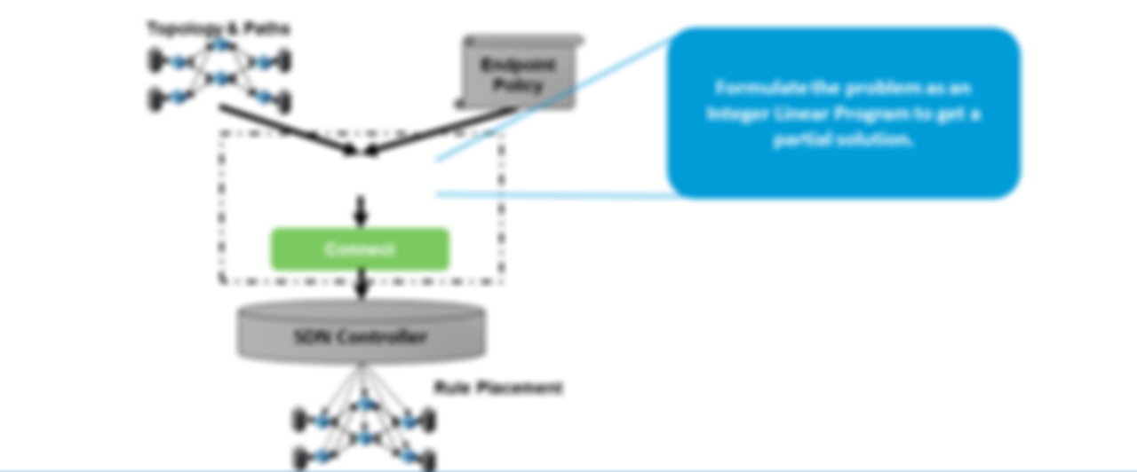
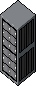

Raptor Overview
Topology & Paths
Formulate the problem as an Integer Linear Program to get a partial solution.
Endpoint Policy
Solve the Integer Linear Program without ordering constraint.
Diffuse
Connect
SDN Controller
Rule Placement
Raptor
Notes:
The First phase, diffuse, we solve the ILP without ordering constraint to get a partial solution.

Slide 23
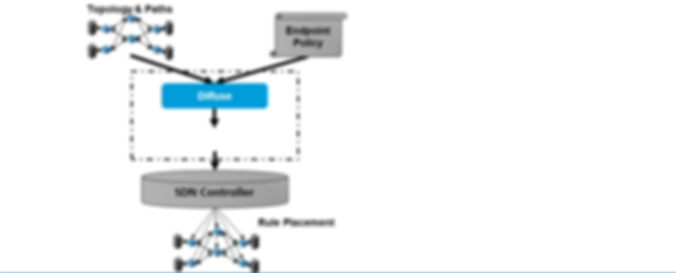
Raptor Overview
Topology & Paths
Endpoint Policy
Diffuse
Connect
Re-arrange the rules to maintain ordering
SDN Controller
Rule Placement
Raptor
Notes:
Let me now go into the solution,
Given the Topology(with the selected paths) and the endpoint policy.
We go through two phases.

Slide 24
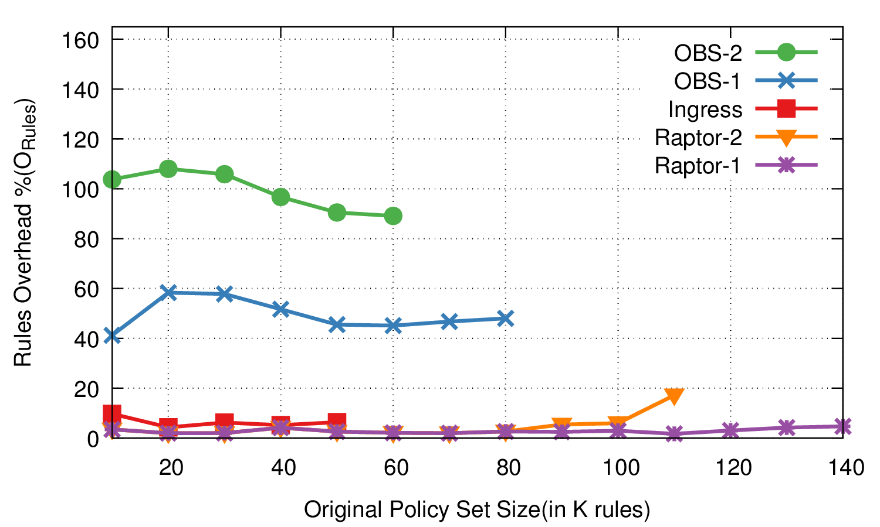
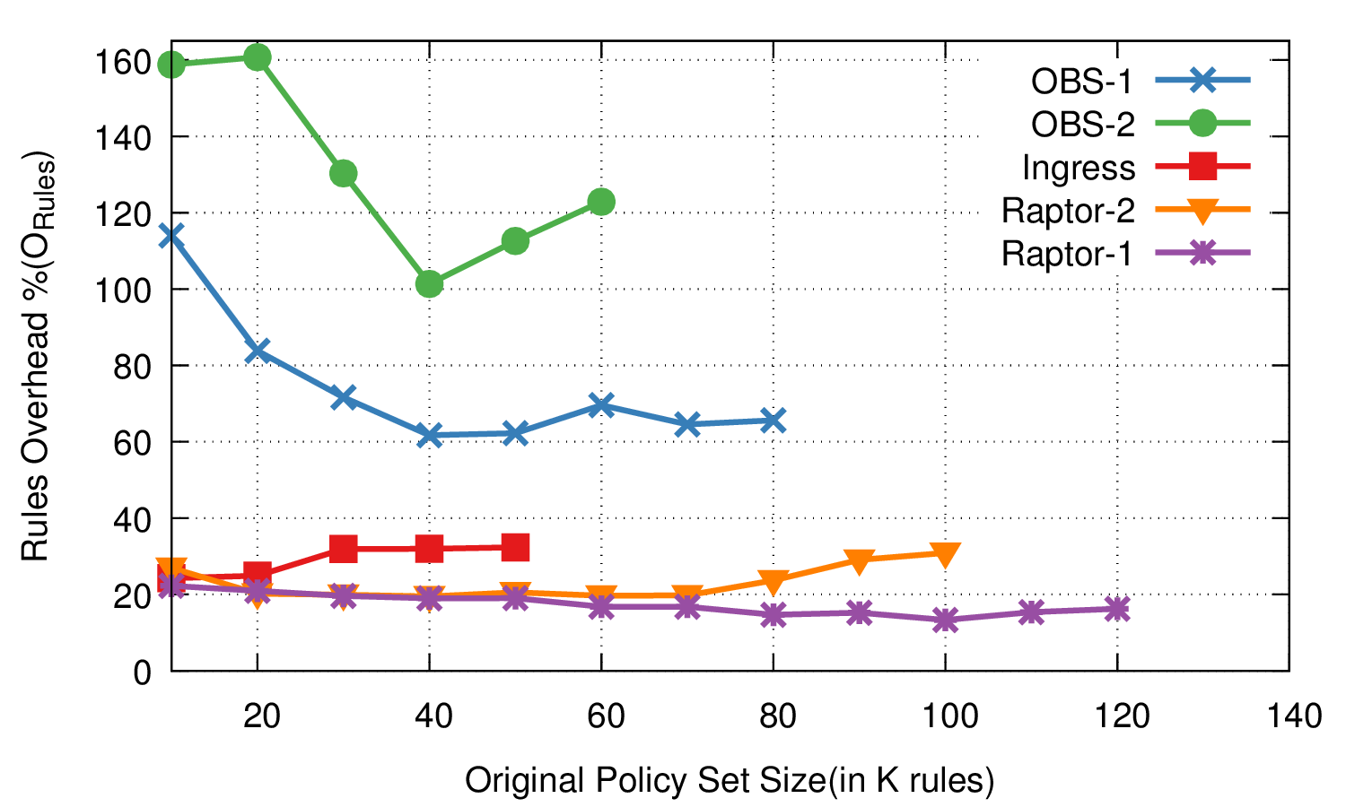
Evaluation – for Fat-Tree
Fat-Tree-8 – Less Overlap
Fat-Tree-8 – More Overlap
Save 40-100% over OBS-1;
80-140% over OBS-2
Scales 3X over Ingress
1.75X over OBS
Raptor
Notes:
In FatTree-8, we observe savings of 40-60% over OBS-1 for less overlapping policies.
Adding to that, we observe that we are able to accommodate larger policy-set for a given topology and switch tcam size.

Slide 25
BNV : Enabling High-Fidelity Experimentation
through Bare-metal Network Virtualization

Slide 26
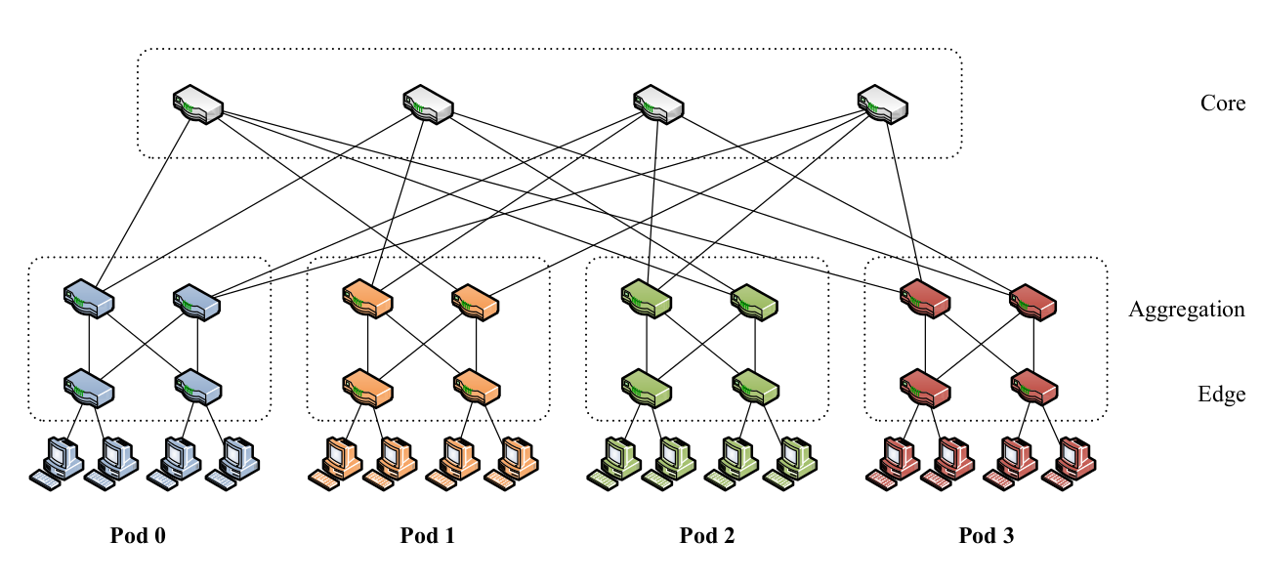
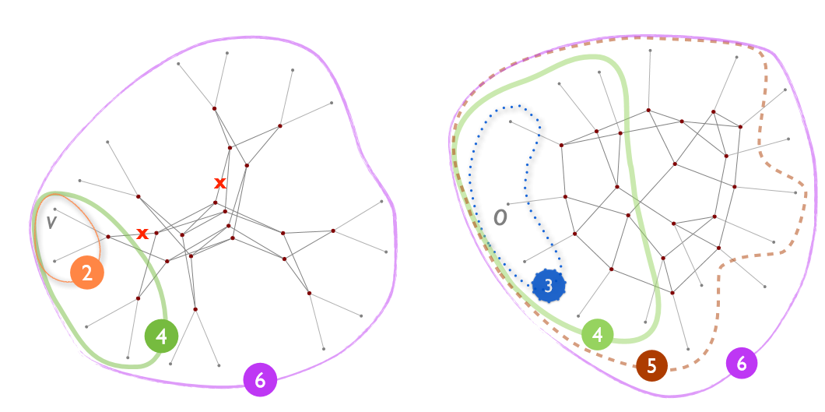
How to validate Innovative Ideas?
App1
App2
App n
SDN Controller
Optimizing Topologies
OpenFlow
Congestion Control
Forwarding
Bandwidth Allocation
Forwarding
Forwarding
Forwarding
CONDOR [SIGCOMM 15] : No Single Topology is optimal for all use cases
Notes:
New paradigms and architectures such as SDN have added an unprecedented increase n the rate of Research & Development conducted in the field of computer networks.
Be it Looking out for new topologies for data-centers, designing congestion control protocols or bandwidth allocation, There is a need to validate the new ideas in an environment which can guarantee high-fidelity and provide flexibility.

Slide 27
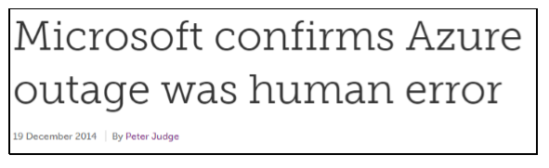
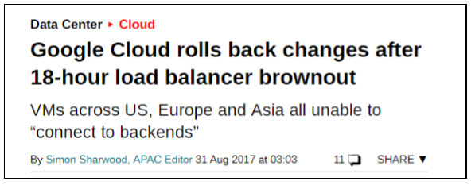
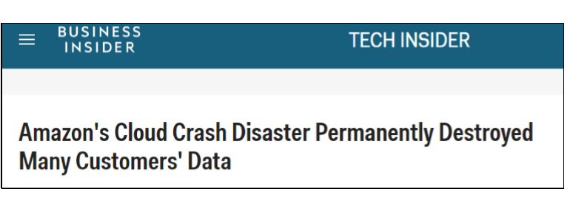
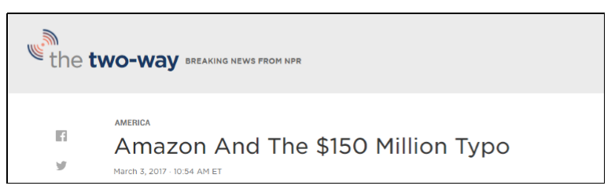
Can a Staging environment reliably mimic production?
Notes:
In Big Environments, small configuration issues could bring down the network causing large outages.
To minimize the outages, the configuration changes could be tried out in staging environment which can reliably mimic production at scale.

Slide 28


Software Tools : Flexible
Mininet, Maxinet: Elegant tools enabling functional testing/ learning.
Container-based virtualization on a single machine or cluster of machines.
Cannot achieve the peak line-rate performance testing.
Notes:
In many cases, experiments rely on software network emulation tools like mininet, maxinet gns3 etc.
These tools allow experimenters to create network topologies very quickly on the host machines using container-based techniques
However, since they run on the CPU of the machines they are hosted on, the network performance highly depends on the deployment environment.
Also, they cannot achieve peak line-rate for performance testing

Slide 29
Network Testbeds – High Fidelity
DeterLab, CloudLab, GENI, Staging Platforms:
Can provide high fidelity emulation with Bare-Metal provisioning.
Can provide only a fixed topology or subset for programmable networks.
Change in Topology are in the order of days to months for wiring changes.
Notes:
Network testbeds such as cloudlab, deterlab and other platforms provide high-fidelity environment for network experimentation.
However, they consider the network as an infrastructure rather than tools to be experimented with.
Though some testbeds like GENI provide network that are programmable, they can only provide a fixed topology or a subset of the substrate topology.
In order to get fexilbility/ change in topology it would take in the order of days to months for wiring changes

Slide 30

How do we achieve the flexibility of software and fidelity of hardware?
Topology Scaling : one-to-many switch virtualization
Notes:
So, How do we achieve the flexibility of software tools, and fidelity of hardware based testbeds?
The answer is topology scaling, i.e. to virtualize a single switch to many virtual switches in an arbitrary fashion

Slide 31
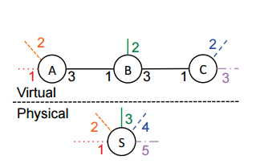
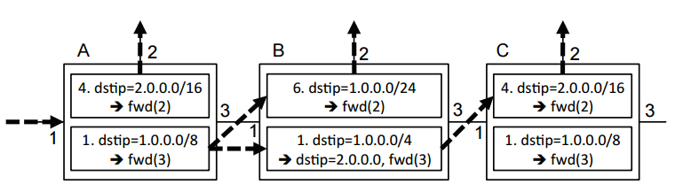
Topology Scaling (one-to-many virtualization)
CoVisor [NSDI 2015]
256; inport = 1,dstip = 2.0.0.0/16; fwd(2)
112; inport = 1,dstip = 1.0.0.0/24; fwd(3)
76; inport = 1,dstip = 1.0.0.0/8; dstip = 2.0.0.0, fwd(4)
4 o 0 o 0
1 o 6 o 0
1 o 1 o 4
Symbolic Path Generation
Priority Augmentation
Notes:
CoVisor performs one-to-many virtualization of a switch using policy composition.
In this example, A single switch S is virtualized into 3 different switches logically.
Now, assume the 3 switches have 2 rules in each of them for forwarding.
So, what CoVisor does is analyzes the rules in each switch, and combines the rules when applying to the physical switch in such a way that the correctness is right, in terms of priority.

Slide 32
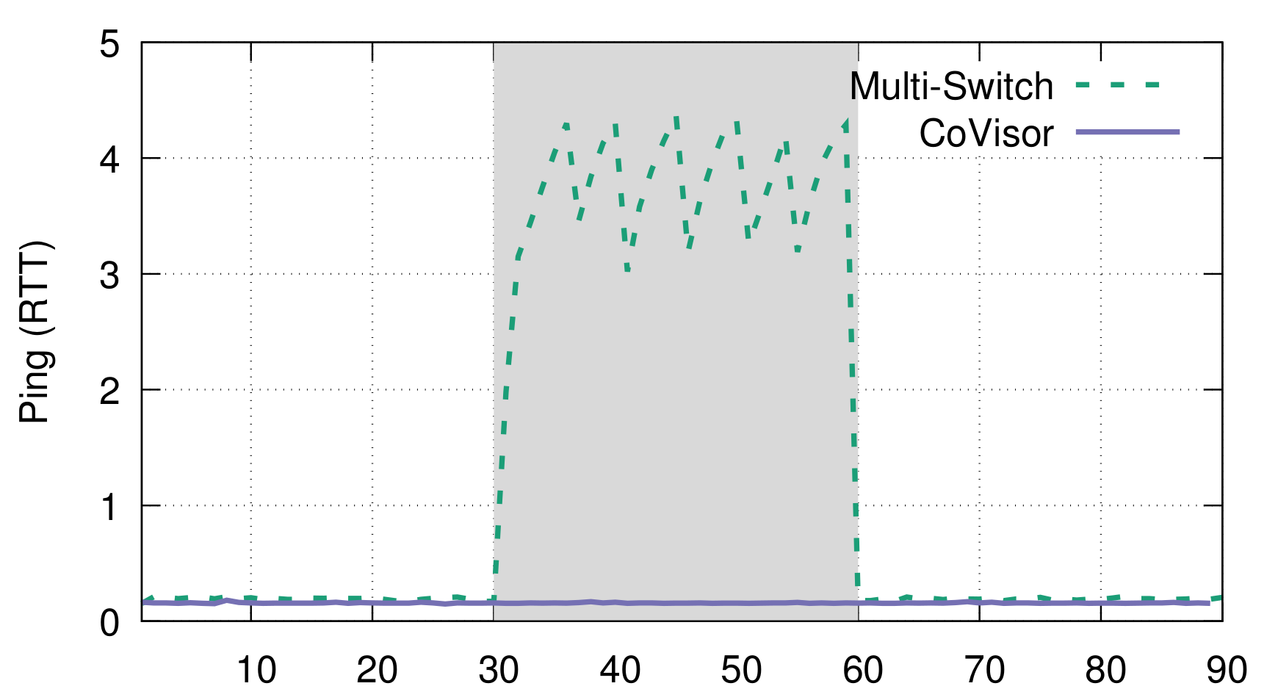
Topology Scaling (one-to-many virtualization)
CoVisor [NSDI 2015] : Doesn’t capture Queuing behavior
H2
H3
1G
iperf
1G
H1
1G
S1
1G
S2
1G
H4
Ping
H2
H3
1G
iperf
1G
H1
1G
S1
1G
H4
Ping
Notes:
However, Since, it manipulates the policies to emulate multiple switches, it doesn’t capture the queuing behavior between the switches.
So, to demonstrate that, we have a experiment with 4 hosts,
Initially, we have 4 hosts, and 2 switches, the links are 1G each, we run continuous ping from h1 to h4, from 30th to 60th second, we run iperf between H2 and H3, sharing the same bottleneck link.
So, what we observe happens to the ping’s RTT is shown in the green dashed lines, since the iperf traffic fills the queues, thus increasing the latency of the ping traffic.
So, with covisor composing policies, we cannot observe the queing behavior since it switches in the backplane, and there is no
link

Slide 33



Tenant 1
Tenant 2
Tenant 3
Tenant n
FatTree, JellyFish, HyperCube, HyperX, Xpander, Arbitrary topologies…etc
OpenDaylight Controller
ONOS Controller
POX Controller
Any SDN Controller
…
Virtual Topology
Network Hypervisor
Tenant Mapping
OpenFlow
Switch1
Switch2
Switch3
Notes:
So, what we ideally need is a network hypervisor, which can take the substrate switches, and the users’s topologies, and allow users’s to control their network from there on.
Regardless of the topologies.

Slide 34
Tenant 1
Tenant 2
Tenant 3
Tenant n
FatTree, JellyFish, HyperCube, HyperX, Xpander, Arbitrary topologies…etc
OpenDaylight Controller
ONOS Controller
POX Controller
Any SDN Controller
…
Virtual Topology
BNV
Topology Abstraction
BNV Mapper
Tenant Mapping
Flow Translation
OpenFlow
Switch1
Switch2
Switch3
Notes:
So, BNV is the network hypervisor, which connects the switches using OpenFlow.

Slide 35
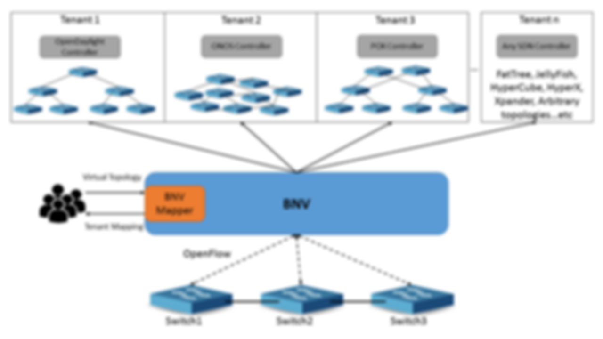
Topology Abstraction
Flow Translation
Notes:
Lets look at how topology is abstracted to make 3 switches to many arbitrarily connected switches.

Slide 36
GENERIC Topology
pSwitch1
CLink1
pSwitch2
5
10G
5
1
2
3
4
1
2
3
4
H1
H2
H3
H4
H5
H6
H7
H8
Notes:
Lets see a generic topology with 2 switches, and 8 hosts. The hosts are connected to the switch using 1G links and 10G backhaul links.

Slide 37
vS1
vL1
vS3
V1
1
3
2
1
V3
2
1G
3
1G
1G
vL3
vS2
vL2
2
1
3
V2
Virtual Topology
Physical Topology
pSwitch1
CLink1
pSwitch2
5
10G
5
1
2
3
4
1
2
3
4
H1
H2
H3
H4
H5
H6
H7
H8
Notes:
Now, if we want to embed a virtual topology with 3 switches to this infrastructure, The mapping will be done as follows.

Slide 38
vS1
vL1
vS3
V1
1
3
2
1
V3
2
1G
3
1G
1G
vL2
vS2
vL2
2
1
3
V2
Virtual Topology
Physical Topology
pSwitch1
CLink1
pSwitch2
5
10G
5
1
2
3
4
1
2
3
4
H1
H2
H3
H4
H5
H6
H7
H8

Slide 39
vS1
vL1 -> CLink1
vS3
V1
1
3
2
1
V3
2
1G
3
1G
1G
vL3
vS2
vL2
2
1
3
V2
Virtual Topology
Physical Topology
pSwitch1
CLink1
pSwitch2
5
10G
5
1
2
3
4
1
2
3
4
H1
H2
H3
H4
H5
H6
H7
H8

Slide 40
vS1
vL1 -> CLink1
vS3
V1
1
3
2
1
V3
2
1G
3
1G
1G
vL3
vS2
vL2
2
1
3
V2
Virtual Topology
Physical Topology
pSwitch1
CLink1
pSwitch2
5
10G
5
1
2
3
4
1
2
3
4
H1
H2
H3
H4
H5
H6
H7
H8

Slide 41
vS1
vL1 -> CLink1
vS3
V1
1
3
2
1
V3
2
1G
3
1G
1G
vL3
vS2
vL2 -> CLink1
2
1
3
V2
Virtual Topology
Physical Topology
pSwitch1
CLink1
pSwitch2
5
5
1
2
3
4
10G
1
2
3
4
H1
H2
H3
H4
H5
H6
H7
H8

Slide 42
Final Mapping
vS1
vL1 -> CLink1
vS3
V1
1
3
2
1
V3
2
1G
3
1G
1G
vL3 -> Bounce Link
vS2
vL2 -> CLink1
2
1
3
V2
Virtual Topology
Physical Topology
pSwitch1
CLink1
pSwitch2
5
5
1
2
3
4
10G
1
2
3
4
H1
H2
H3
H4
H5
H6
H7
H8

Slide 43
Link 1 using Packet Tagging
PKT
V1
vS1
vL1 : Tag 1
vS3
V3
1
2
3
2
1
3
Tag 3
Tag 2
vS2
2
1
3
V2
Virtual Topology
Physical Topology
pSwitch1
PKT
1
PKT
pSwitch2
5
CLink1
5
1
2
3
4
1
2
3
4
PKT
H1
H2
H3
H4
H5
H6
H7
H8

Slide 44
Link 2
V1
vS1
vL1: Tag 1
vS3
V3
1
2
3
2
1
3
PKT
Tag 3
vL2: Tag 2
vS2
2
1
3
V2
Virtual Topology
Physical Topology
pSwitch1
PKT
CLink1
PKT
2
pSwitch2
5
5
1
2
3
4
1
2
3
4
H1
H2
H3
H4
PKT
H5
H6
H7
H8

Slide 45
Link3 :
Bounce back Link
V1
vS1
vL1: Tag 1
vS3
V3
1
2
3
2
1
3
vL3: Tag 3
vL2: Tag 2
vS2
2
1
3
V2
Virtual Topology
PKT
Physical Topology
Core link Overhead
PKT
3
pSwitch1
PKT
CLink1
pSwitch2
5
5
1
2
3
4
1
2
3
4
H1
H2
H3
H4
H5
H6
H7
H8
PKT

Slide 46
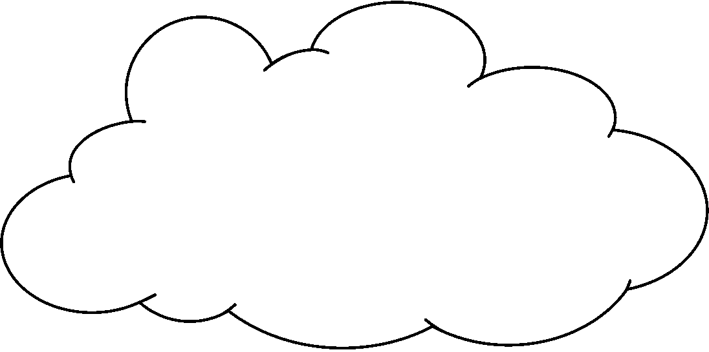
Y
Size of Virtual network
Core Network
Capacity L
Capacity L
NL/2
H Ports
H Ports
……
NL/4
N Switches
X
NH
Always
Feasible
Feasibility depends on topology
X: Number of Hosts Y: Number of inter-switch links
Notes:
In order to gauge the size of a network that could be virtualized using this approach. Consider N switches having H ports connected to host, and backhail link of capacity L. Consider the host links are of capacity 1 unit.
In the best case, upto NL/2 switch-to-switch links can be supported.. In the worst case, the mapping places all switch-pairs with connected links in the same physical switch thus, using up more core-capacity.
Hence, NL/4 switch-to-switch links can be supported.

Slide 47
Can we do better?

Slide 48
Idea : Loopback links in substrate topology

Slide 49
Idea : Loopback links in substrate topology

Slide 50
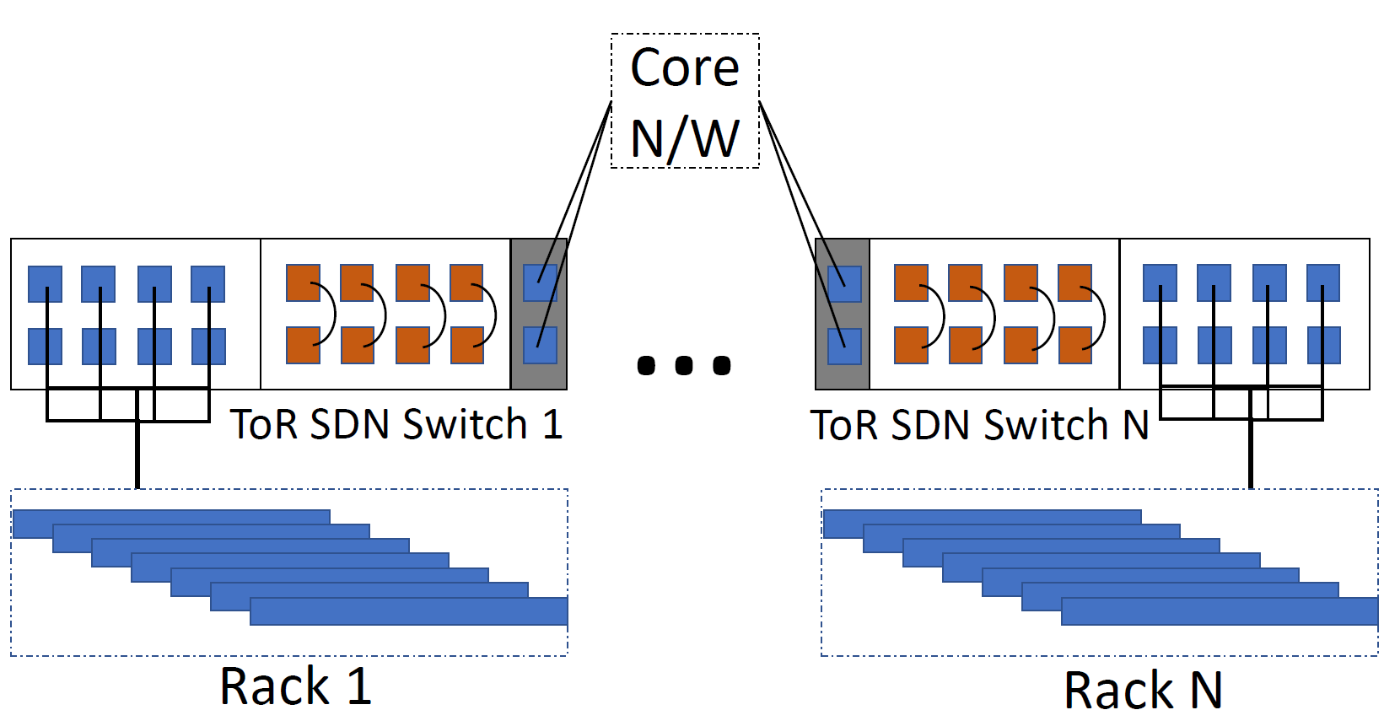
Idea : Loopback links in substrate topology

Slide 51
Topology + Loopback link
pSwitch1
CLink1
pSwitch2
5
5
1
2
3
4
1
2
3
4
H1
H2
LoopLink1
H5
H6
LoopLink2

Slide 52
V1
vS1
vL1 -> CLink1
vS3
V3
1
2
3
2
1
3
vL2 -> CLink1
vS2
2
1
3
V2
Virtual Topology
Physical Topology
pSwitch1
5
CLink1
pSwitch2
5
1
2
3
4
1
2
3
4
H1
H2
LoopLink1
H5
H6
LoopLink2

Slide 53
V1
vS1
vL1 -> CLink1
vS3
V3
1
2
3
2
1
3
vL3 -> LoopLink1
vL2 -> CLink1
vS2
2
1
3
V2
Virtual Topology
Physical Topology
pSwitch1
5
CLink1
pSwitch2
5
1
2
3
4
1
2
3
4
H1
H2
LoopLink1
H5
H6
LoopLink2
Notes:
Now, with loopback links, the mapping vL3 can be mapped to the looplink1 instead of the CLink1

Slide 54
Link3 :
Loop Link
H1
vS1
VL1 : Tag 1
vS3
H5
1
2
3
2
1
3
1) Consistency & Fidelity of mapping.
vL3: Tag 3
vL2: Tag 2
vS2
2
1
3
H2
Virtual Topology
PKT
2) No Traffic Overhead in Core Link.
Physical Topology
pSwitch1
CLink1
pSwitch2
5
5
1
2
3
4
1
2
3
4
H1
H2
LoopLink1
H5
H6
LoopLink2
PKT
Notes:
Now, advantages are that :
1) This mapping resermbles an actual switch to switch link
2) It causes no overhead on the core link.

Slide 55
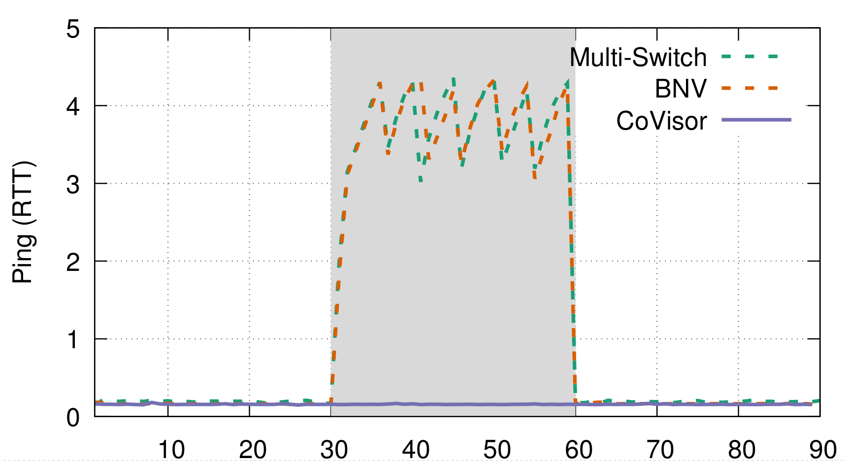
Topology Scaling (one-to-many virtualization)
H2
H3
1G
1G
H1
1G
S1
1G
S2
1G
H4
Ping
H2
H3
1G
iperf
1G
H1
1G
S1
1G
H4
Notes:
Taking a look at the initial experiment to see how loopbacks compare to two physically connected switches, we repeat the same experiment with an experiment containing loopback link to emulate two connected switches.

Slide 56
Size of Virtual network
Y
NL/2+NH/2
Gain using loopback links
In Always feasible region.
Core Network
NL/4+NH/2
Capacity L
Capacity L
NL/2
H Ports
H Ports
How do we decide how many
loopback links
per switch?
……
NL/4
N Switches
X
NH
Always
Feasible
Feasibility depends on topology
X: Number of Hosts Y: Number of inter-switch links
Notes:
Checking the size of the network that can be emulated using loopback links.
The H ports of the switches can either connect to a host or be a loopback link.

Slide 57
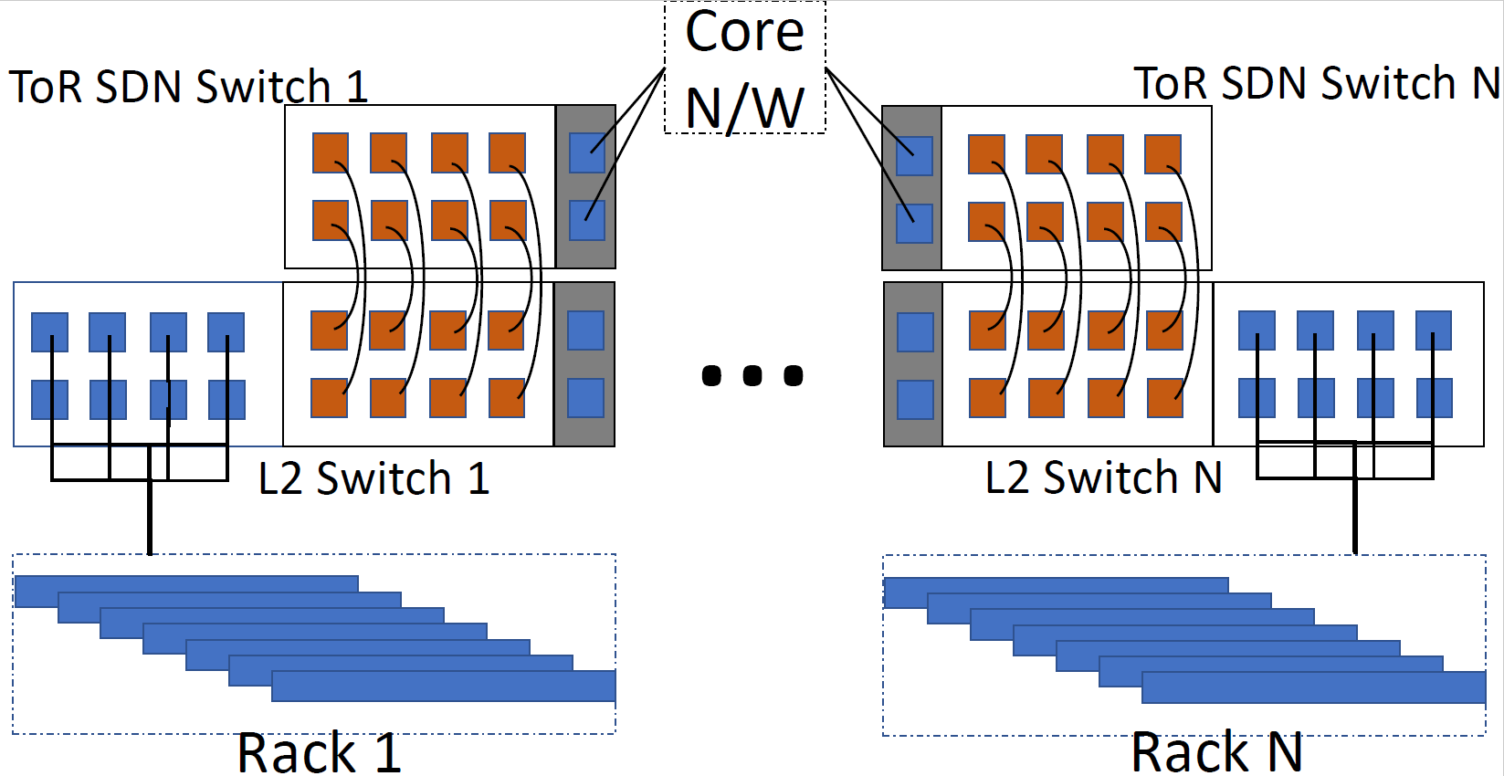
Software-Configurable Loopbacks
Notes:
Additionally, we can also make loopback entirely dynamic and software configurable if we can interconnect the servers and the SDN switch using an L2 switch,
Then, we can manipulate VLANs to create loopbacks or connect servers as the demand arises.

Slide 58
Tenant 1
Tenant 2
Tenant 3
Tenant n
FatTree, JellyFish, HyperCube, HyperX, Xpander, Arbitrary topologies…etc
OpenDaylight Controller
ONOS Controller
POX Controller
Any SDN Controller
…
Virtual Topology
BNV
Topology Abstraction
BNV Mapper
Tenant Mapping
Flow Translation
OpenFlow
Switch1
Switch2
Switch3

Slide 59
Tenant 1
Tenant 2
Tenant 3
Tenant n
FatTree, JellyFish, HyperCube, HyperX, Xpander, Arbitrary topologies…etc
OpenDaylight Controller
ONOS Controller
POX Controller
Any SDN Controller
…
Virtual Topology
BNV
Topology Abstraction
BNV Mapper
Tenant Mapping
Flow Translation
OpenFlow
Switch1
Switch2
Switch3

Slide 60
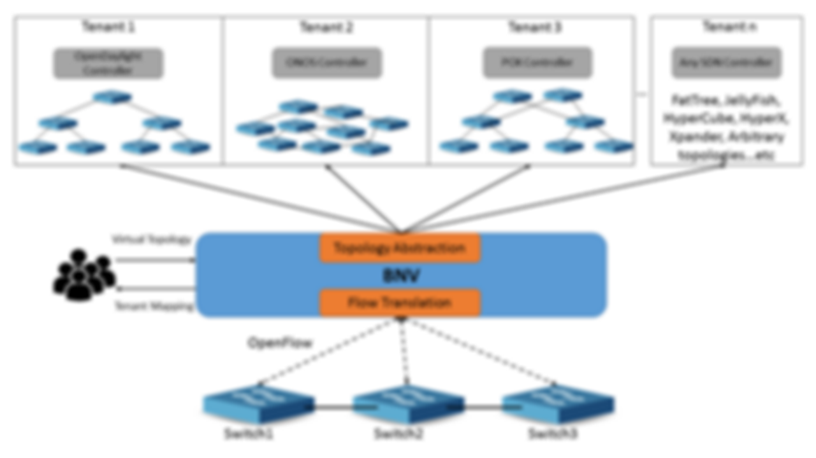
BNV Mapper
Notes:
Lets look at how the network embedding is done using BNV Mapper

Slide 61
BNV Mapper (Virtual Network Embedder)
Request
1
1
BNV
Mapper
10
1
1
1
1
Mapping

Slide 62
BNV Mapper
A Virtual Topology Consists of :
A set of hosts V,
A set of (virtual) switches S,
A set of (virtual) links L
Core Link
Host Link
H1
H2
H3
H4
H5
H6
H7
H8

Slide 63
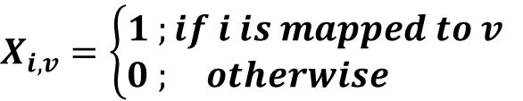
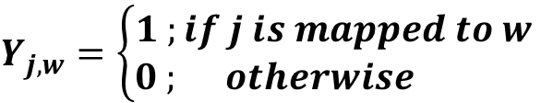
BNV Mapper
Solved using ILP
Variables :
$$X_{i,v}=\left\{\begin{aligned}1 ;if i is mapped to v \\ 0 ; otherwise \end{aligned}\right.$$
Core Link::
$$Y_{j,w}=\left\{\begin{aligned}1 ;if j is mapped to w \\ 0 ; otherwise \end{aligned}\right.$$
Host link:
Notes:
BNV Mapper is basically an ILP formulation with variables for core link and host link.

Slide 64
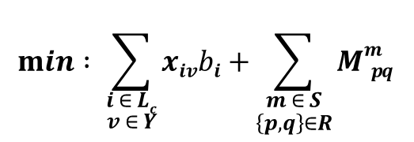
BNV Mapper
Objective is to Minimize the usage of Core-links:
a) Maximizes isolation to the tenant, keeping links dedicated.
b) Provides scope for dynamic expansions. (Adding/upgrading tenants)
$$min : \sum_{\begin{aligned}i ∈ Lc \\ v ∈ Y\end{aligned}}{xivbi+}\sum_{\begin{aligned}m ∈ S \\ \left\{p,q\right\}∈R\end{aligned}}{Mmp q }$$
Inter-Switch
Links
Big-Switch abstraction
Notes:
The objective of the formulation is to minimize the usage of core links,
1) Why we do this is to maximize the isolation to the tenant, by giving dedicated links when possible.
2) Additionally, it provides scope for expansions using core links by providing locality to the embedding.

Slide 65
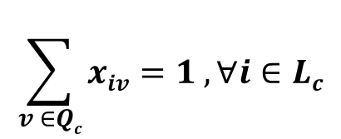
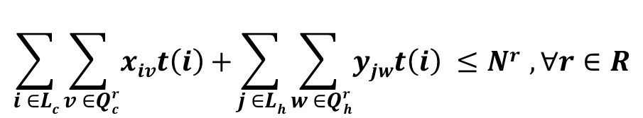
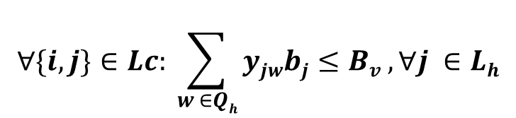
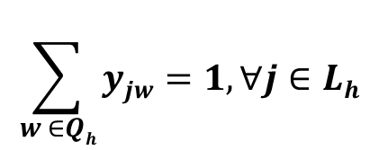
BNV Mapper - Constraints
$$\sum_{v ∈Qc}{xiv=1 ,∀i∈Lc}$$
1) Core Link one-to-one mapping:
$$\sum_{w ∈Qh}{yjw=1,∀j∈Lh}$$
2) Host Link one-to-one mapping:
$$∀\{i,j\}∈Lc: \sum_{w ∈Qh}{yjwbj≤Bv ,∀j ∈Lh}$$
3) Host Link Bandwidth constraint:
$$\sum_{i ∈Lc}{\sum_{v ∈Qrc}{xivt\left(i\right)+}}\sum_{j ∈Lh}{\sum_{w ∈Qrh}{yjwt\left(i\right) ≤Nr },∀r∈R}$$
4) TCAM capacity constraint
Notes:
So, the constraints are core links mapping, host link mapping, host link bandwidth constraint and TCAM capacity constraint so that we do not allocate beyond the capacity of the switch.

Slide 66
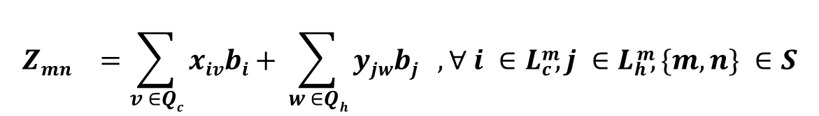
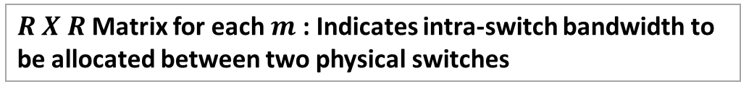
BNV Mapper - Constraints
5) One Big Switch Abstraction:
Total Bandwidth of $virtual switch m$mapped to n
$${Zmn}^{}=\sum_{v ∈Qc}{xivbi+ }\sum_{w ∈Qh}{yjwbj , ∀ i ∈Lcm, j ∈Lhm, \{m,n\} ∈S}$$
$R X R$Matrix for each $m$ : Indicates intra-switch bandwidth to be allocated between two physical switches
$${Mmpq}^{}=min \left(Zmp, Zmq\right), ∀m∈S, \{p,q\}∈R$$
Notes:
So, with the mapper, recall that we can either map a single switch into many switches and the other way, i.e. many switches into a single switch.
When we map many switches into a single switch, we need to account for the backplane bandwidth to be allocated between the switch port.
So, this constraint takes care of that. Let me explain using an example.

Slide 67
BNV Mapper – Big Switch Abstraction
H1
vSwitch1
H8
H2
H3
H4
H7
Virtual Topology
Physical Topology
Core Network
To | B/W
H4 | 1G
H7+H8 | 2G
To | B/W
H1+H2+H3 | 2G
H4 | 1G
To | B/W
* | 1G
CLink1
CLink2
CLink3
pSwitch1
pSwitch2
pSwitch3
1
2
3
1
2
3
1
2
3
H1
H2
H3
H4
H5
H6
H7
H8
H9
Notes:
Consider a vswitch1 with hosts allocated using servers across 3 different switches
Pswitch1 has 3 hosts, pswitch2 has 1 host and pswitch3 has 2 hosts allocated from substrate to constitute vswitch1.
So, using bnvmapper, we identify the maximum bandwidth to be allocated for the core link between the switches.
For example, the core link1 needs 3G provisioned since that maximum traffic that can be received by the other hosts is 3.
However since corelink 2 can only generate/ receive 1G traffic, we ratelimit the traffic to that. So going back to the formulation..

Slide 68
BNV Mapper - Constraints
5) One Big Switch Abstraction:
Total Bandwidth of $virtual switch m$mapped to n
$${Zmn}^{}=\sum_{v ∈Qc}{xivbi+ }\sum_{w ∈Qh}{yjwbj , ∀ i ∈Lcm, j ∈Lhm, \{m,n\} ∈S}$$
$R X R$Matrix for each $m$ : Indicates intra-switch bandwidth to be allocated between two physical switches
$${Mmpq}^{}=min \left(Zmp, Zmq\right), ∀m∈S, \{p,q\}∈R$$
Notes:
So, This constraint calculates the bandwidth between each physical switch which belongs to a same virtual switch, and allocates the minimum between a pair of phy switches.

Slide 69
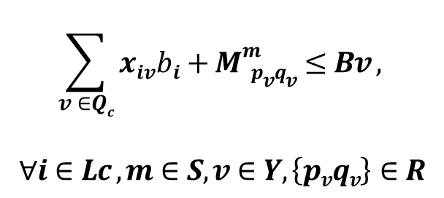
BNV Mapper - Constraints
6) Core Link Bandwidth constraint:
Inter-Switch
Links
Intra-Switch
fabric
$$\sum_{v ∈Qc}{xivbi+}Mmp vqv≤Bv ,$$
$$∀i∈Lc ,m∈S,v∈Y,\left\{pvqv\right\}∈R$$
Notes:
Finally, the core link bandwidth constraint which accounts both the inter-switch and intra-switch bandwidth.

Slide 70
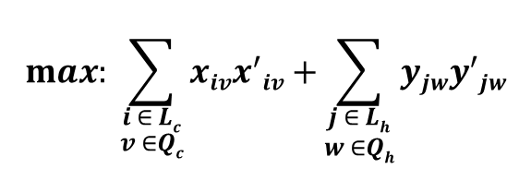
BNV Mapper – Topology Convertibility
Re-run the ILP with the modified objective
To maximize using the same switch-ports/links
$$max: \sum_{\begin{aligned}i ∈ Lc \\ v ∈Qc\end{aligned}}{xivx^{′}iv+}\sum_{\begin{aligned}j ∈ Lh \\ w ∈Qh\end{aligned}}{yjwy^{′}jw}$$
Notes:
Additionally, tenants may need to change their topology dynamically. So to do that, we rerun the ILP with a modified objective to maximize the usage of the same ports/ links allocated to the topology.

Slide 71



Implementation
Implemented on top of
Integrated with a Bare-metal provisioning service (Testbed).
Deployed on NCL Production Environment.
Notes:
We implemented BNV on top of OpenVirteX, which is an existing network hypervisor. Additionally integrated with a bare-metal provisioning service deterlab.
It is currently deployed on NCL production environment for experimenters to spawn SDN based experiments with arbitrary topologies.

Slide 72
Implementation
Support OpenFlow 1.0/ 1.3
MAC address encodes <Tenant-id, Link-Id>
Rate-limiting using Switches’ classifier based QoS.
Notes:
Our implementation supports OpenFlow 1.0 & 1.3.
We implement the link tagging by encoding it in Mac address when a packet enters the network and by removing the tag when it leaves the network.
The rate-limiting is implemented in the switches using classifier based QoS which overrides OpenFlow.

Slide 73
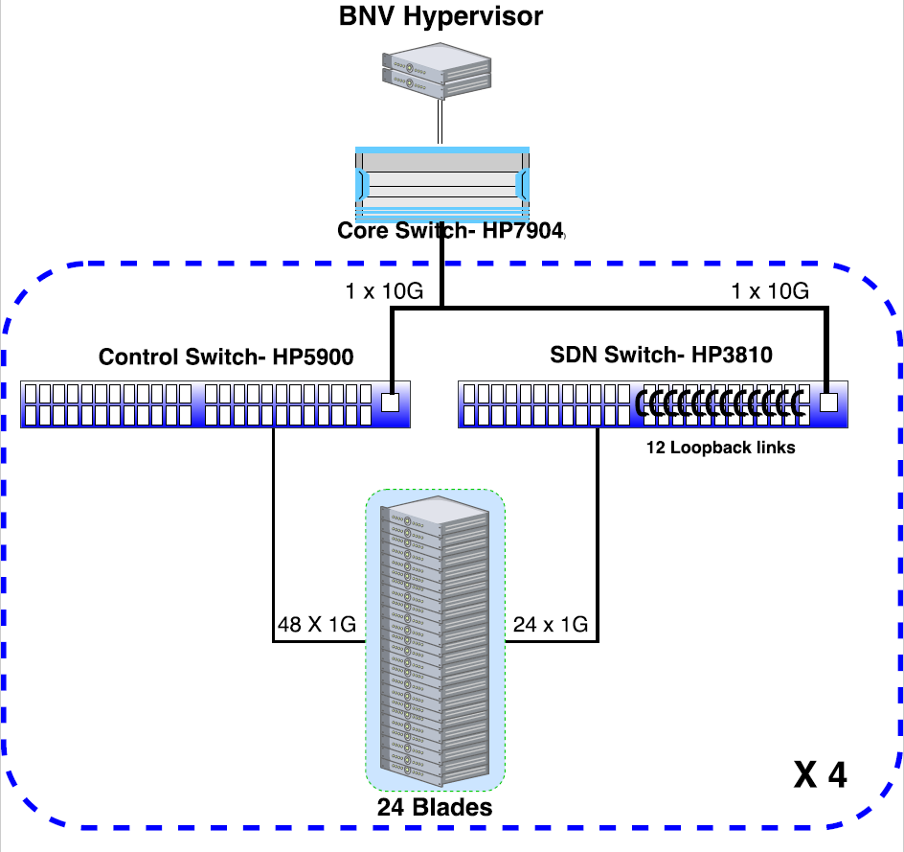
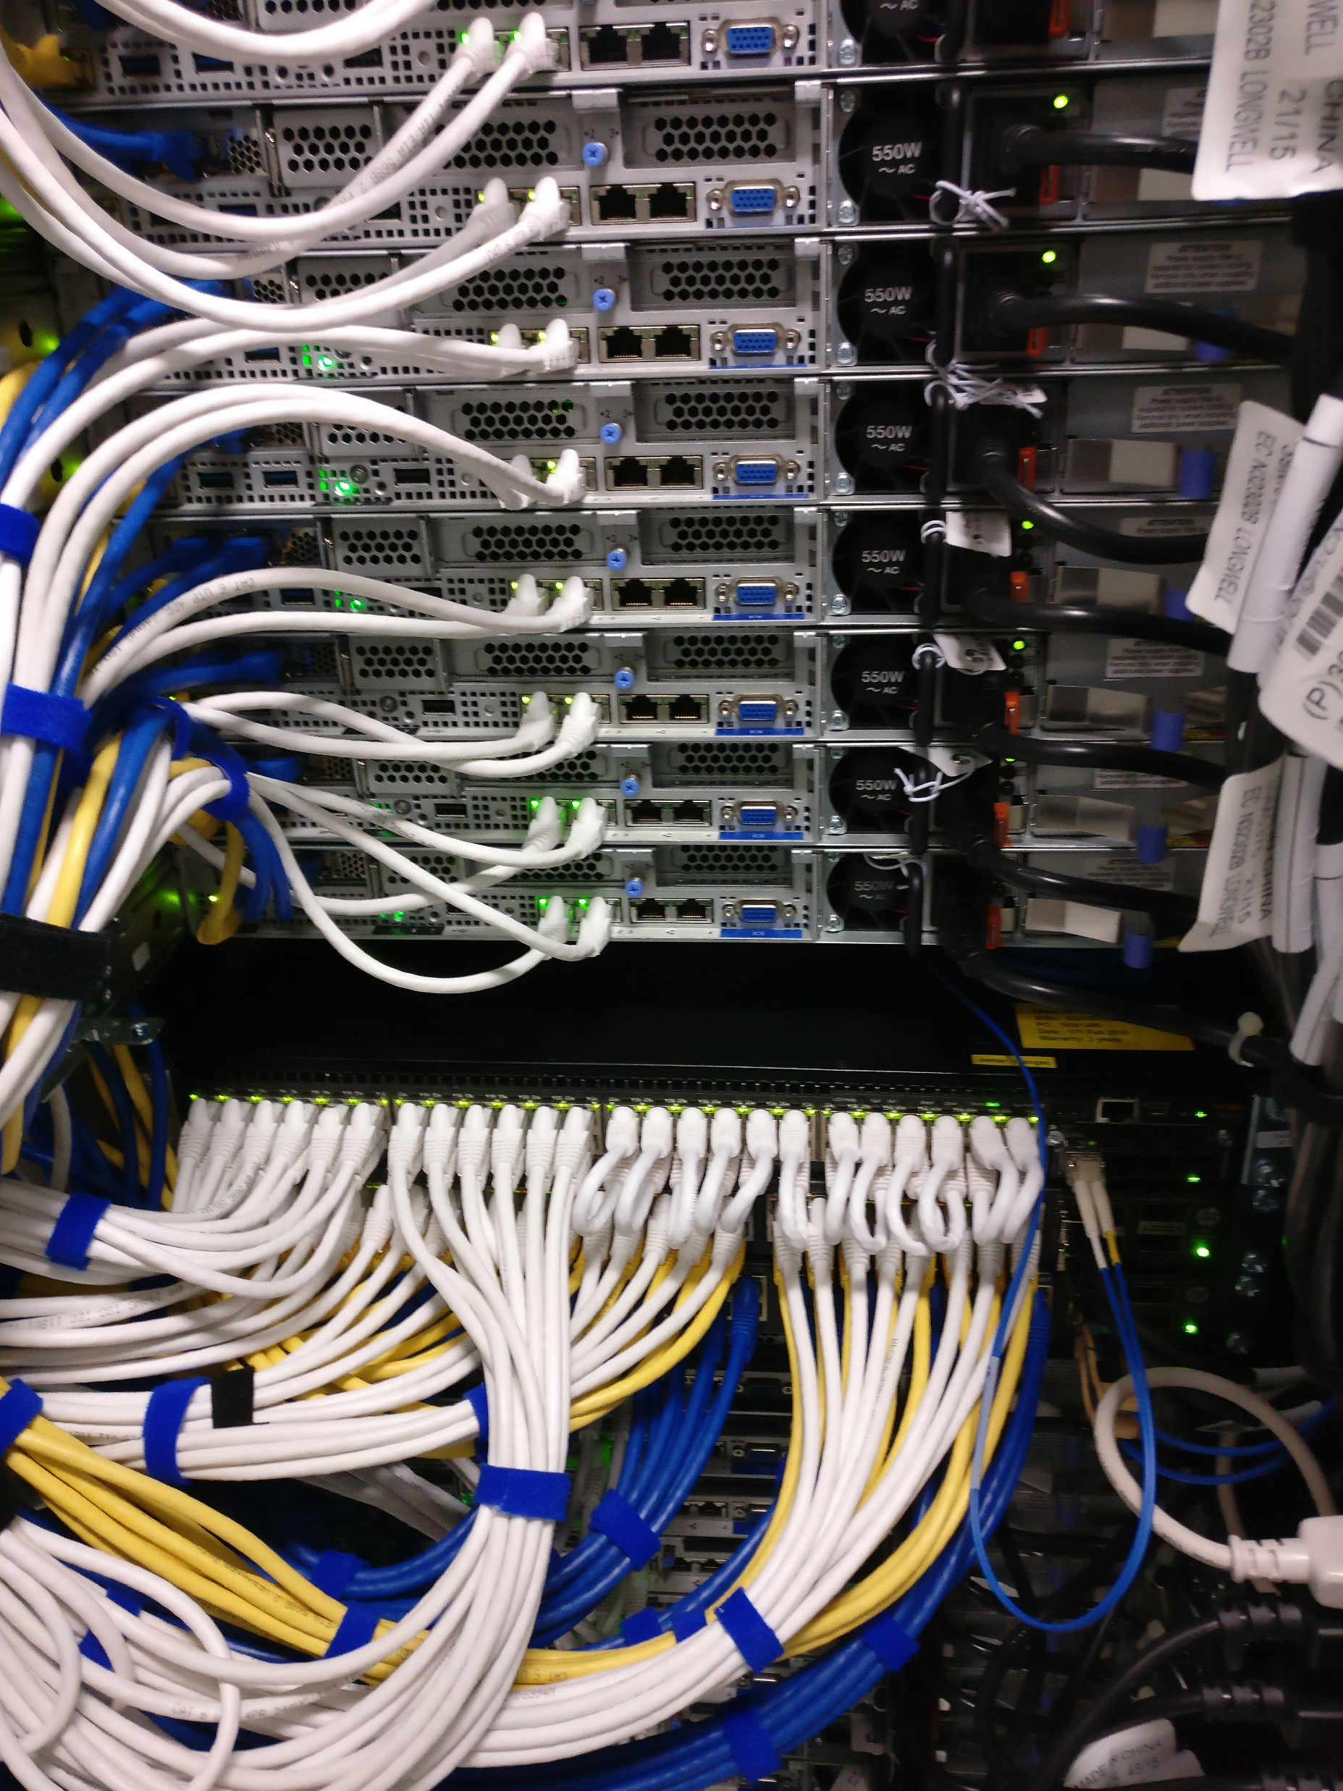
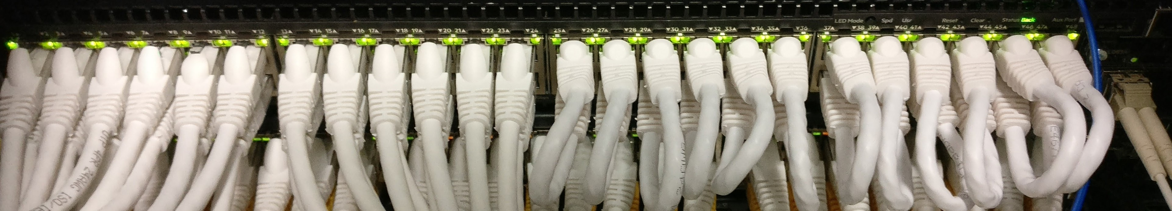
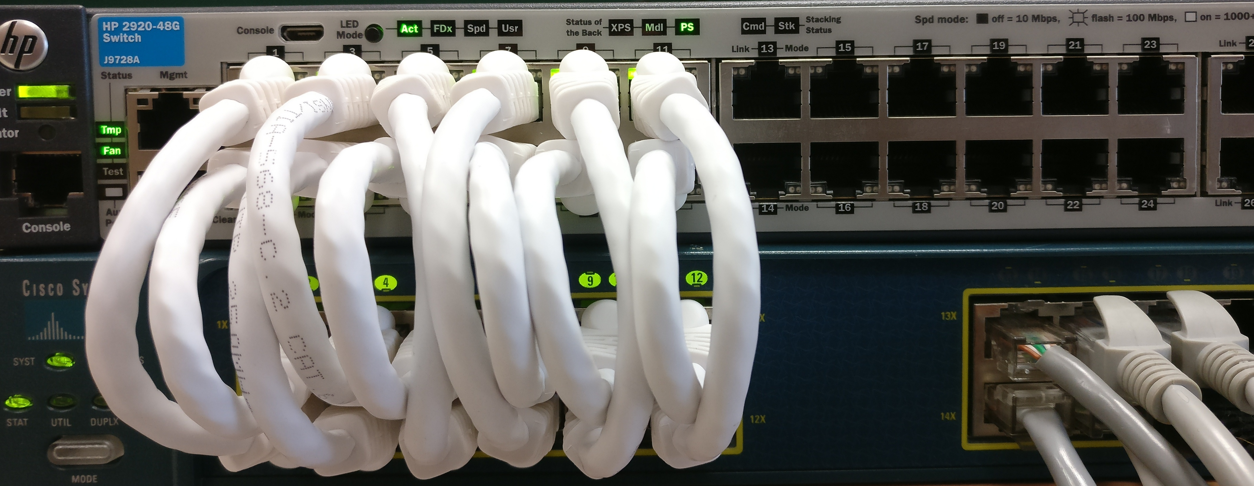
Implementation
Static loopback wiring
24-ports of SDN Switch
Dynamic Loopback Wiring
using L2 intermediate Switch
Notes:
The implementation platform over 4 clusters of 24 blades is shown in the figure. We use 12 loopbacks per SDN switch. Thus enabling 12 switch-to-switch links within the same switch.
We have also testbed dynamic loopback wiring in a staging setup.

Slide 74
Evaluation
Can BNV faithfully replicate behaviour of topologies?
Provide control/data plane isolation to multiple tenants?
Scale of complex topologies embedded?
Notes:
To evaluate BNV, we seek answers to 3 questions :
Can bnv faithfully replicate the behavior of topologies.
Can we provide control/ dataplane isolation to multiple tenants/ experimenters?
How big topologies can be embedded using BNV?

Slide 75
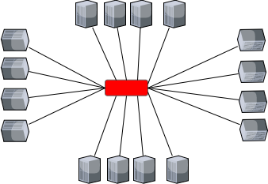
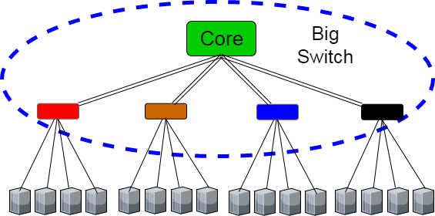
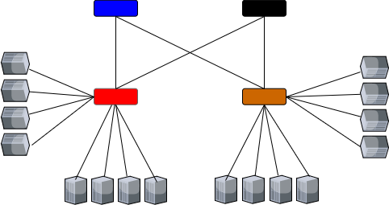
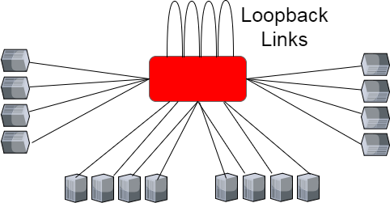
Evaluation : loopbacks & Big Switch Abstraction
Notes:
Lets answer the first question using application behavior:
We emulate star topology with multiple switches in our topology using the big switch abstraction.
And we emulate clos topology with a single switch in BNV using loopbacks

Slide 76
Evaluation : loopbacks & Big Switch Abstraction

Slide 77
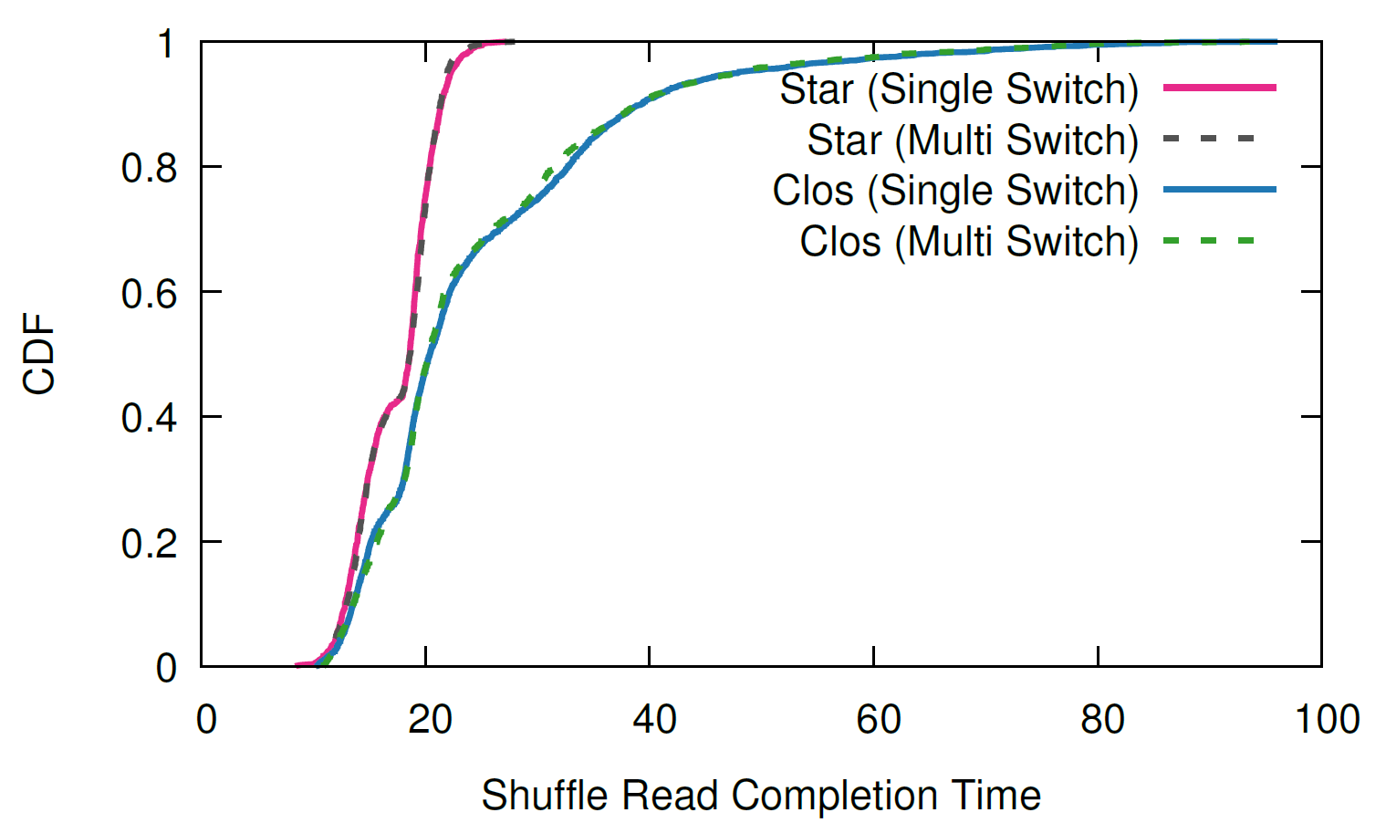
Evaluation : loopbacks & Big Switch Abstraction
Star (Single Switch)
Star (Multi Switch)
Clos (Multi Switch)
Clos (Single Switch)
Notes:
We run a wordcount application on apache spark for a large amount of data (50GB) and plot the CDF of the shuffle read completion times.
Note that the intended topology on the left is the actual topology’s behavior
We observe that either the topology is emulated using a single switch or multiple switches, it has the same behavior in terms of the shuffle read times of the spark.

Slide 78
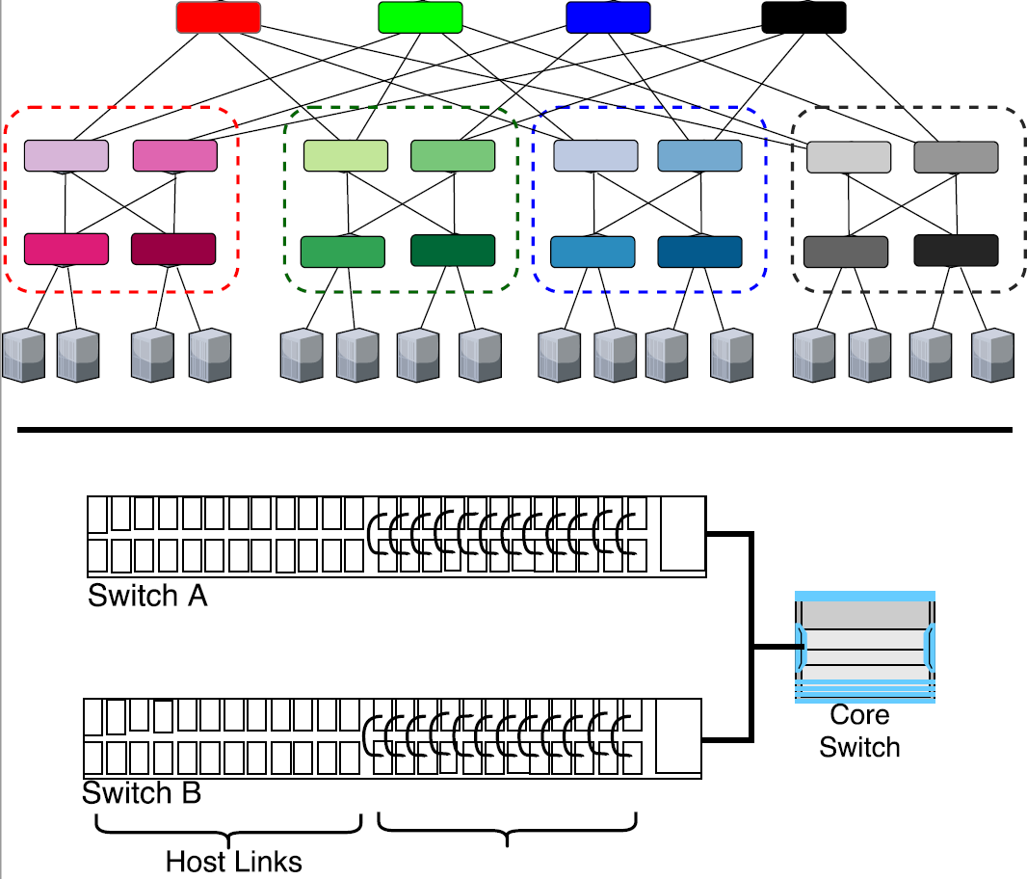
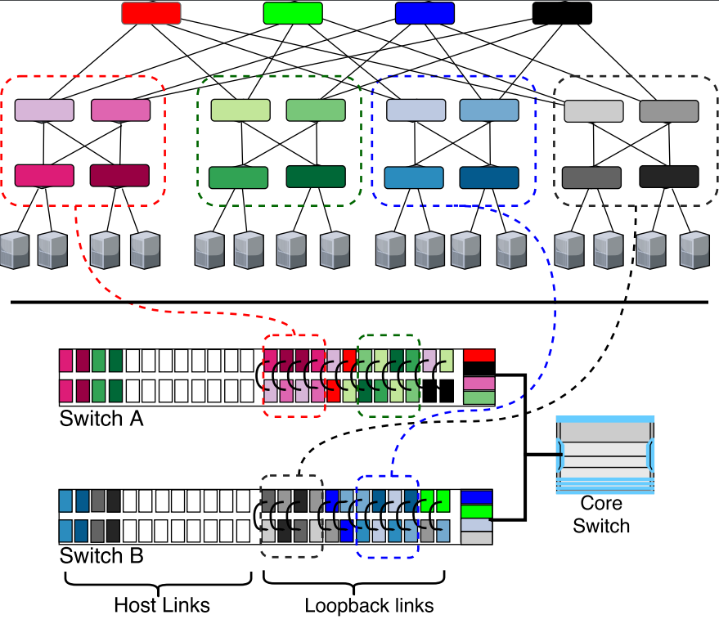
Mapping Complex Topologies
Notes:
So, in this illustration we show how we can map a fat-tree topology with degree 4 on BNV’s substrate topology with just 2 switches.
Each pod links are emulated using the loopbacks, and the core links are used to inter-connect pods.

Slide 79
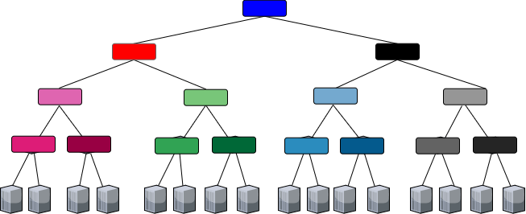
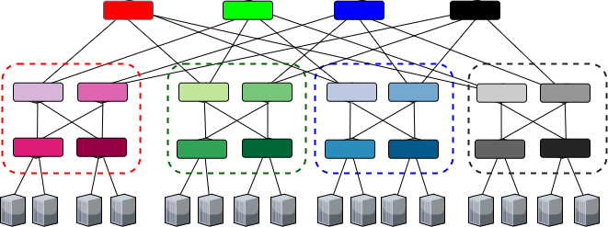
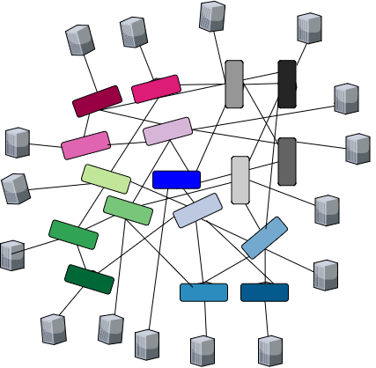
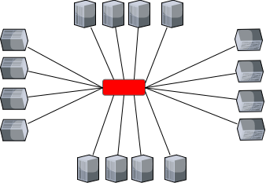
Evaluation : Fidelity of Complex Topologies
Single-Rooted Tree
Fat Tree
Jellyfish
Star
Notes:
In This experiment, we embed 4 topologies on BNV, to observe the application behavior on each of the virtual topology which have same no. of hosts, but the network topology different.
We run Hadoop and apache spark. We display the results of apache spark

Slide 80
Evaluation : Fidelity of Complex Topologies
Single-Rooted Tree
Fat Tree
Fat Tree
Single-Rooted Tree
Fat Tree
Single-Rooted Tree
Fat Tree
Single-Rooted Tree
Fat Tree
Single-Rooted Tree
Fat Tree
Single-Rooted Tree
Fat Tree
Single-Rooted Tree
Fat Tree
Single-Rooted Tree
Fat Tree
Single-Rooted Tree
Fat Tree
Single-Rooted Tree
Fat Tree
Single-Rooted Tree
Fat Tree
Single-Rooted Tree
Single-Rooted Tree
Fat Tree
Jellyfish
Star
Jellyfish
Star
Jellyfish
Star
Jellyfish
Star
Jellyfish
Star
Jellyfish
Star
Jellyfish
Star
Jellyfish
Star
Jellyfish
Star
Jellyfish
Star
Jellyfish
Star
Jellyfish
Star
Jellyfish
Star

Slide 81

Evaluation : Fidelity of Complex Topologies
Single-Rooted Tree
Fat Tree
Jellyfish
Star
Notes:
As expected Tree has the highest shuffle time due to restricted b/w, and star has the lowest time due to the highest bandwidth

Slide 82
Evaluation : Fidelity of Complex Topologies
Single-Rooted Tree
Fat Tree
Jellyfish
Star

Slide 83
Evaluation : Fidelity of Complex Topologies
Jellyfish
7-8% Lower
Fat Tree
Jellyfish
Low Intra-pod locality
Heavy cross rack traffic!!
28.02
26.32
Notes:
Now lets focus on two topologies FatTree and jellyfish.
Jellyfish performs better than fatree (about 7-8% better). We observe this behavior because the traffic pattern of the application was low intra-pod locality, and there was heavy cross traffic, due to partitions and broadcasts.

Slide 84

Evaluation : Fidelity of Complex Topologies
17.647
19.06
Jellyfish
8% Higher
Fat Tree
Jellyfish
High Intra-pod locality
Low cross rack traffic!!
This observation is backed by Tale of Two Topologies [SIGCOMM ’17]
Take-away: BNV emulates the intrinsic characteristics of the topologies, otherwise observed with heavy wiring & building costs
Notes:
Now, we change the Application’s traffic pattern to create more intra-pod locality and thus low cross rack traffic.
With this change, we observe reduce in shuffle read times. However, more important observation is that now jellyfish observes higher shuffle time than fat-tree.
This observation is same as that observed by a recent paper on convertible topologies using a fully wired network.
Thus, the take-away is that BNV emulates the intrinsic characteristics of topologies, without the need for wiring changes and building costs.

Slide 85


Evaluation : Isolation of multiple tenants
Fat Tree
Take-away: BNV can support multiple arbitrary tenants providing isolated & repeatable environments.
Jellyfish
Random (Rest of the nodes)
Notes:
Next, we evaluate BNV’s ability to achieve traffic isolation between multiple experiments/tenants.
So, we spawn three experiments : Fatree running the spark application, jellyfish running iperf between all nodes, and a random topology formed using the rest of the nodes, and capturing ping between the network.
Initially, we run each of the experiment separately, to capture the performance without any other experiment running.
From 60th minute to 80th minute, all 3 expts are running in parallel, we observe that, each expts do not affect each other regardless of its running separately or combined.
So, we can achieve isolated and repeatable enironments using BNV

Slide 86

Evaluation : Scale of Topologies
Notes:
The last set of experiments is a simulation to see how much.
So, the topology we consider is with 5 tor sdn switch, connected to 24 servers and 12 loopbacks each.
The backhaul network is 40Gs

Slide 87

Evaluation : Scale of Topologies
Notes:
We run our experiments consider with and without loopbacks in the network. And plot the percentage of core bandwidth used.
Without loopbacks, we can implement only upto degree 4 of fattree
But with loopback we can go upto degree 6 (with upto 212 links) using the given substrate,

Slide 88

Evaluation : Scale of Topologies
Notes:
Next, we map variations of random topologies, with n switches, and links either as n sqrtn or 2n links.
With loopbacks we observe 2X gain in the scale of topologies that can be supported. Without loopbacks, we tend to do poor also due to use of bounce links which cause additional overhead on the core link.

Slide 89







Evaluation : Scale of Topologies
Internet Topology Zoo dataset
Take-away: Addition of loopback links increases the scalability significantly.
Can emulate topologies with 130 switches and 300 links with just 5 ToR switches
Notes:
Finally, we embed the topologies from topology zoo dataset, and we see with loops we could support upto topologies of 300 links, which covers about 95% of the topologies from the dataset,
Final takeaway is that we can emulate large topologies as much as 130 switches and 300 links with just 5 switches, and still maintaining the fidelity of the emulation.

Slide 90
Summary
BNV provides High-fidelity network experimentation/cloud platform.
BNV can scale a network to support arbitrary topologies using the existing network.
Can emulate networks of more than 100 network devices with just 5 ToR Switches.
Implemented in NCL testbed for over six months for experimentation.
In Submission to SOSR 2018.
Notes:
So, to summarize
BNV can be used to provide an high-fidelity network experimentation platform.
We have implemented BNV in NCL bare-metal based testbed for over six months for experimentation.

Slide 91
Ongoing Work
Support Virtualization for Programmable Data-Plane P4:
Use-Cases:
Composable data-plane for modularity.
Different tenants running completely independent protocols.
A/B Testing of data-plane protocols.
Network upgrades and snapshots.
Notes:
Next, I am working on enabling virtualization of data-plane in P4.
So, the purpose of doing that would be to :
Achieve modularity while programming data-plane ( using parallel and sequencial operations of various basic p4 programs), so that its easier for operators to enable/disable features.
Enabling multiple tenants program their own set of data-plane functionalities sharing the same infrastructure
Enabling A/B testing of protocols by releasing only to a select few.
Easing network upgrades and snapshotting.

Slide 92
Ongoing Work
Approach :
Compose multiple programs using compile-time analysis and re-factoring.
Identify Tenant/
Program
Merge Parsers, Ingress Table, Egress Tables
Notes:
The approach I have taken is by composing multiple programs using compile time analysis and re-factoring of the tables and parsers.

Slide 93
Data Path 1
Data Path 2
Data Path 3
P4 Runtime Hypervisor
Protobuf
Meta
➔
Push BNV header
Pop BNV header
BNV header =>
BNV header =>
Notes:
After refactoring, lets assume the topology, the bnvp4 would need to integrate with p4 runtime, to identify the topology, and combine p4 programs at the edge using the meta-data.
At the edge, the p4 program would add a BNV header (16-bit tenant-id), and at the egress edge, it will pop the header and forward.
Currently, I can combine multiple p4 programs to make s super p4 program of them.
I am in progress of integrating with p4 runtime to implement the end-to-end solution. Once I do that, I want to see the performance

Slide 94

Thank You

Slide 95
Backup

Slide 96




Related Work
Network Hypervisors
FlowVisor[OSDI ’10] VeRTIGO[EWSDN ’12] OpenVirteX[HotSDN ’14]
Switch Abstractions
VINI[SIGCOMM ’06] Trellis[CoNEXT ’08] Mininet[CoNEXT ’12] MaxiNet[Networking ’14]
MiniReal[ICC ’17] CrystalNet[SOSP ’17]

Slide 97


